Slide 1

PHISHING ATTACK SIMULATION AND TRAINING

Slide 2
TEAM MEMBERS
Mostafa Helal Atia Mohamed
Mohamed Yasser Rabie
Mostafa Ahmed Abbas
Nofir Nasr Atta Qandil
Mahmoud Walid Rajab Askar

Slide 3

PHISHING ATTACK SIMULATION AND TRAINING

Slide 4
1. INTRODUCTION
Phishing attacks are one of the most common cybersecurity threats facing organizations today
Implementing a phishing attack simulation and training program can help educate employees, assess vulnerabilities, and improve the organization's security posture
This documentation provides a step-by-step guide on how to implement a phishing simulation program, conduct training, and measure its effectiveness

Slide 5
1.1 PURPOSE
The purpose of this document is to outline the procedures and best practices for conducting a phishing attack simulation and training within the organization
This simulation is intended to improve employee awareness and prepare the incident response team to handle phishing attacks effectively

Slide 6




1.2 GOALS AND OBJECTIVES
To test and evaluate the organization’s incident response capabilities against phishing threats
To identify gaps in security awareness among employees
To enhance the organization's ability to detect and respond to phishing attacks
To strengthen the overall security posture by integrating the findings into the security awareness program

Slide 7




1.2 SCOPE
Develop phishing email templates
Conduct simulated phishing campaigns
Provide training based on the results
Measure success and generate reports

Slide 8

1.2 SCENARIO
Your email address has been leaked and you receive an email from Paypal in German

Slide 9

2.1 DEFINITION OF PHISHING ATTACK
A phishing attack is a form of social engineering in which an attacker sends a fraudulent message to trick individuals into revealing sensitive information or installing malicious software

Slide 10
2.2 GOALS AND OBJECTIVES OF THE SIMULATION
To evaluate the organization’s ability to detect and respond to phishing attempts
To train employees on identifying phishing red flags
To test and enhance the incident response procedures
To measure the effectiveness of security awareness programs

Slide 11
2.3 STAKEHOLDERS
Incident Response Team: Responsible for detecting, analyzing, and responding to the simulated phishing attack
IT Security Team: Manages infrastructure and provides technical support
Training and Awareness Team: Conducts training sessions post-simulation
Employees: Serve as test subjects for the simulation

Slide 12
2.3 TOOLS AND MACHINES USED
KALI LINUX Machine
Window Victim Machine
Software Phishing tool such as: ZPHISHER

Slide 13
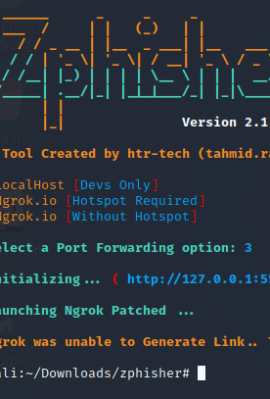
2.3 TOOLS AND MACHINES USED
Zphisher
is an open-source phishing tool designed for creating and hosting fake web pages that mimic legitimate sites to capture sensitive user credentials
It is written in Bash and Python and comes preconfigured with various phishing page templates
Features of Zphisher
Multiple Phishing Templates: Zphisher includes ready-to-use phishing templates for platforms like social media sites, e-commerce, and financial services
No Setup Required: It automatically sets up the server, configures tunneling services, and initiates the phishing page
Support for Custom Pages: Users can create their own custom phishing pages
Tunneling Options: Supports various tunneling methods (Ngrok, Localhost, Cloudflared, LocalXpose

Slide 14
TIMELINE OF EVENTS
Timeline of Events
Preparation Phase
Day 1: Identify target group and create the phishing simulation emails
Day 2: Configure email templates with realistic content mimicking common phishing attacks
Day2: Set up necessary tracking mechanisms to monitor user interaction

Slide 15
TIMELINE OF EVENTS
Execution Phase
Day3
Launch the phishing simulation and send emails to the selected users
Monitor user responses, including clicks on phishing links, data entry attempts, and emails reported
Analysis and Training Phase
Day 4: Analyze the results, document which users fell for the phishing attempt, and identify common weak points
Day 5: Conduct a detailed awareness training session for employees covering phishing indicators and safe practices
Day 6: Follow-up with users who fell for the phishing test and provide additional training

Slide 16
3. PHISHING ATTACK SIMULATION PLANNING
Create phishing scenarios using ZPhisher:
Steps
Start Zphisher
When you run the script, you will see a menu displaying various phishing templates for different platforms
Choose the desired platform by entering its corresponding number

Slide 17
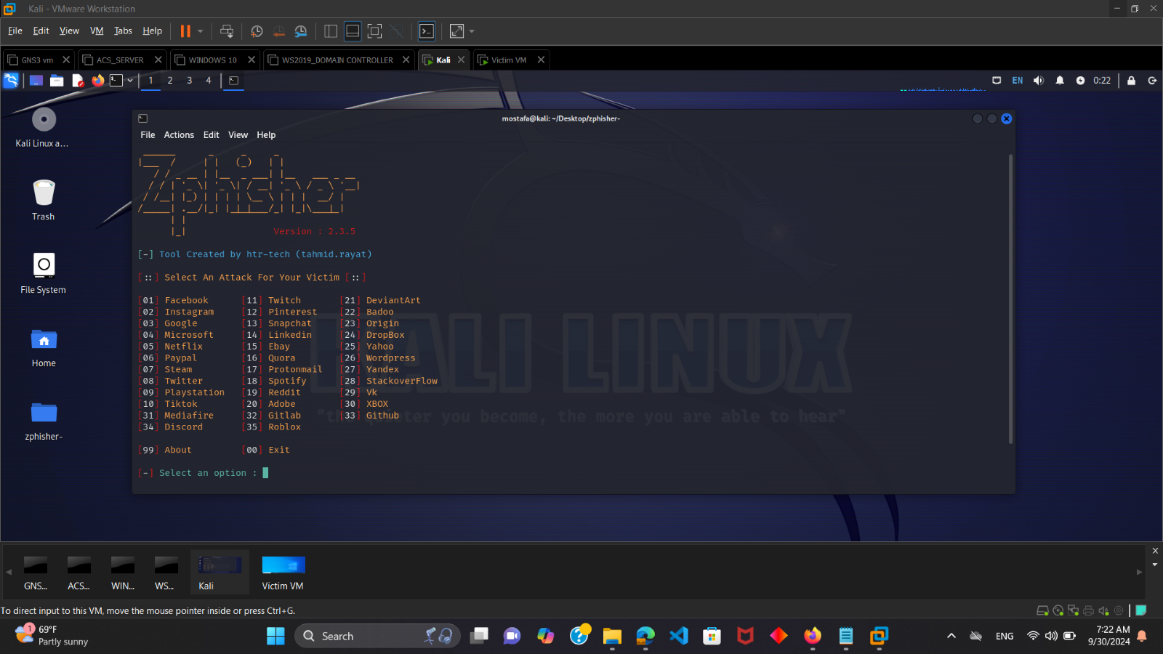
3. PHISHING ATTACK SIMULATION PLANNING START ZPHISHER

Slide 18
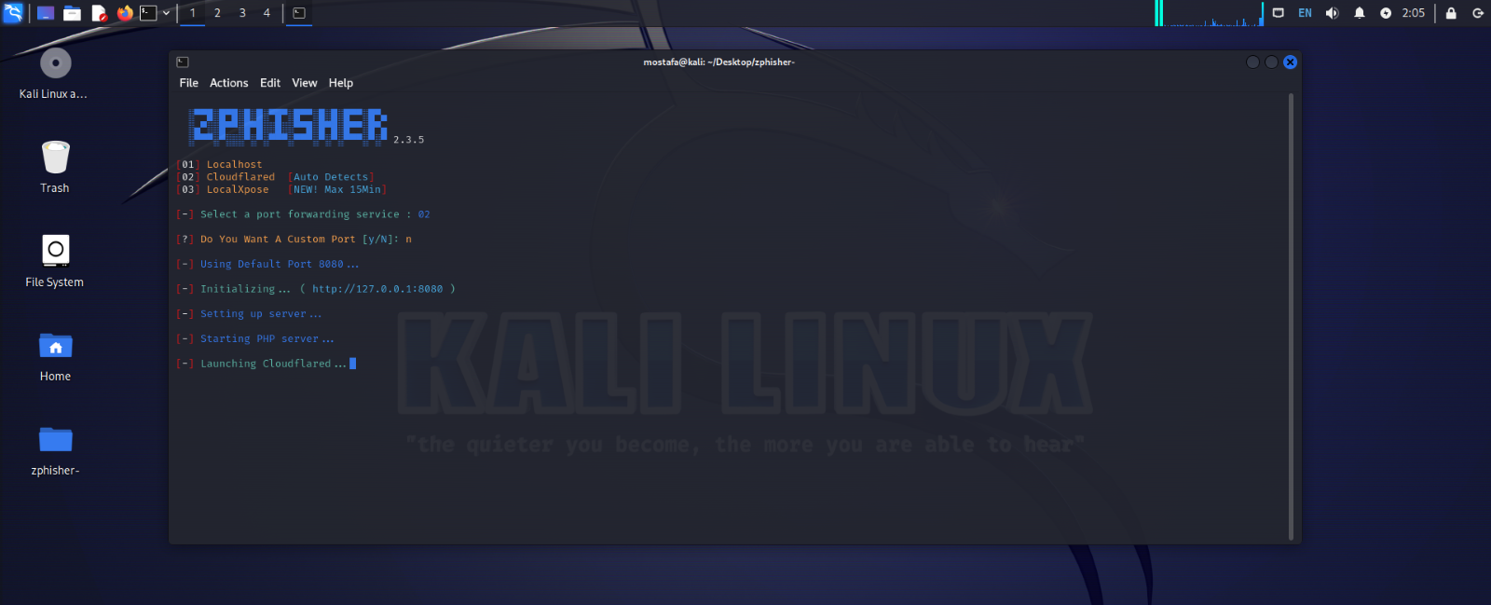
CHOOSE THE TUNNELING SERVICE
After selecting the platform, Zphisher will present you with multiple methods, such as
Localhost
Cloudflared
LocalXpose
Ngrok

Slide 19
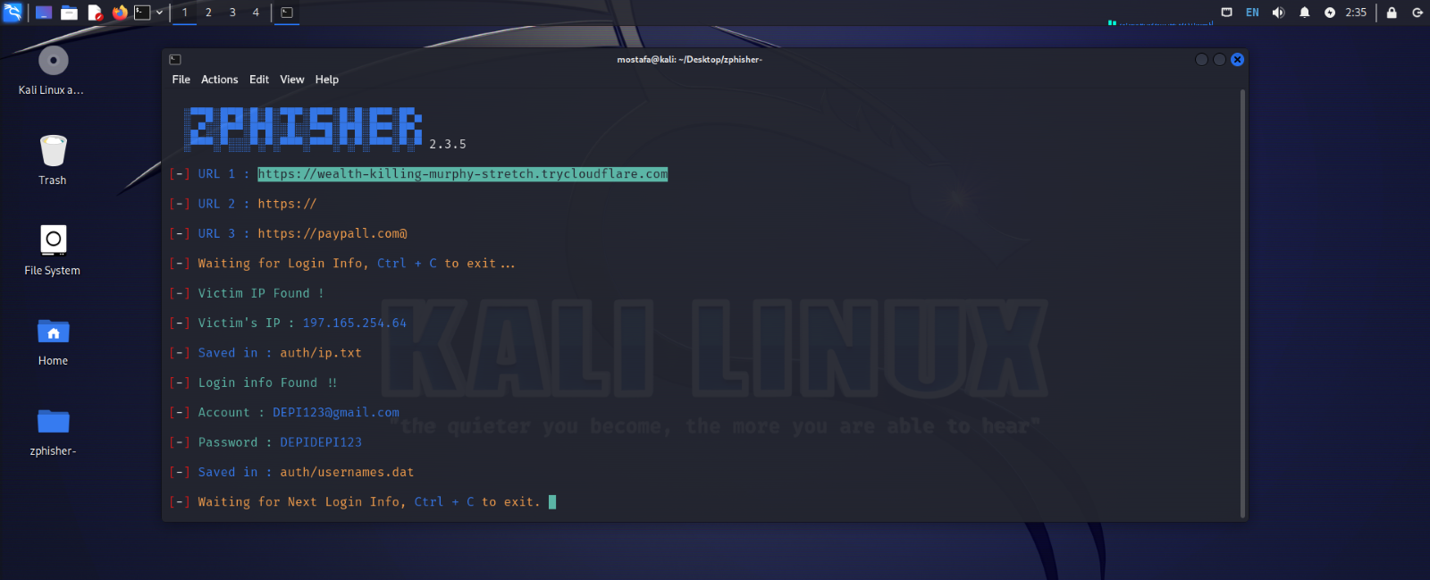
GENERATE THE PHISHING LINK
Once the server is started, Zphisher will generate a phishing link that you can use
Copy this link and send it to your target victim in an email or in an attachment

Slide 20
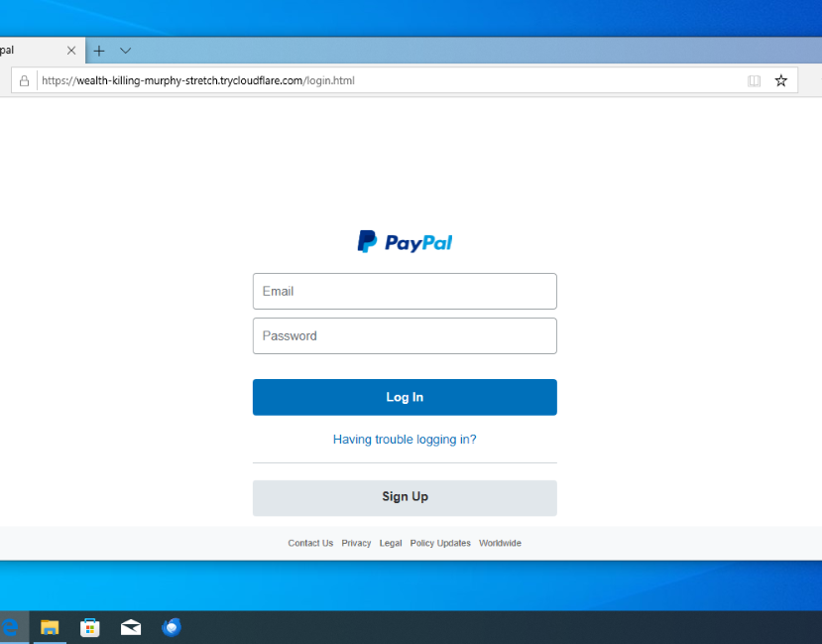
WAIT FOR THE TARGET TO INTERACT
When the target clicks on the link on an email and inputs their credentials, Zphisher will capture the information and display it in your terminal

Slide 21

WAIT FOR THE TARGET TO INTERACT
WHEN THE TARGET CLICKS ON THE LINK ON AN EMAIL
WHEN THE TARGET INPUTS THEIR CREDENTIALS

Slide 22
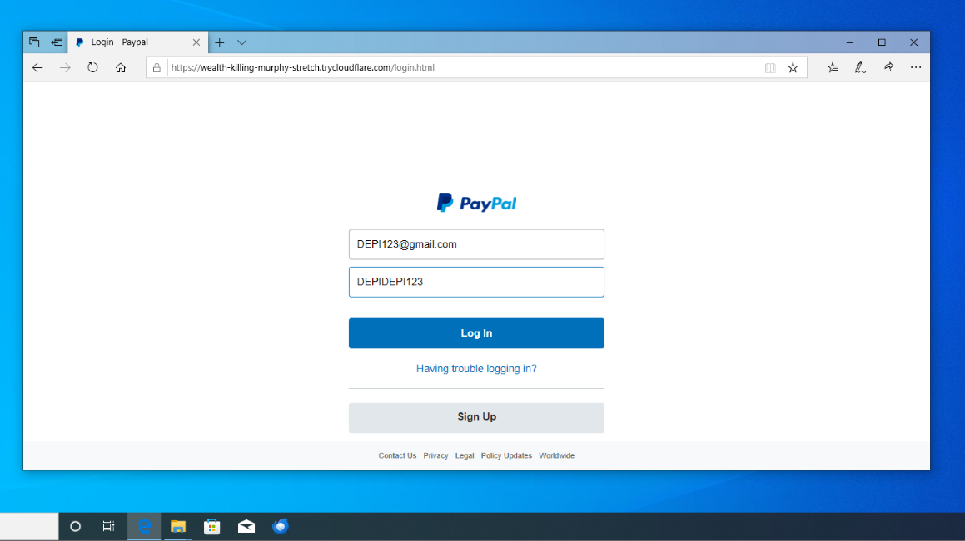
WHEN THE TARGET INPUTS THEIR CREDENTIALS

Slide 23
ANALYZE THE CREDENTIALS
The credentials will be stored in the Zphisher directory
The captured information will include
Ip address of the victim target
Username/Email
Password

Slide 24
ZPHISHER CAPTURE VICTIM CREDENTIALS

Slide 25
3.2 SCHEDULING AND EXECUTION
1
2
3
Determine a schedule for the simulation without notifying employees to maintain authenticity
Use a secure and reputable phishing simulation platform
Design emails to resemble typical company communication to test user vigilance

Slide 26
3.4 TRAINING SETUP
Develop materials such as guides, quizzes, and video training sessions
Schedule a post-simulation training session to review the results

Slide 27
4. PHISHING EMAIL ANALYSIS
What is phishing email analysis?
Phishing email analysis involves studying the content of phishing emails to ascertain the techniques the attacker used
What is a common indicator of a phishing email?
Common indicators of a phishing email include suspicious addresses, links, or domain names, threatening language or a sense of urgency, errors in the email, the inclusion of suspicious attachments, and emails requesting sensitive information
Example of phishing email

Slide 28
5. INCIDENT RESPONSE STEPS 1.DETECTION AND ANALYSIS
Initial Analysis
Identify and categorize the phishing email based on its nature
Use automated tools to analyze the email's headers, sender, and content
Check for Indicators of Compromise such as malicious links or attachments
Documenting IOCs
Record the sender’s email address, subject line, URLs, and file hashes for future reference
Investigate if the same email was sent to multiple recipients
Employee Reporting
Ensure that employees know the correct procedure for reporting suspicious emails
Use phishing reporting buttons(if available in email clients) to streamline the process
Identify employees who interacted with the phishing email.
Determine if any sensitive information was submitted.

Slide 29
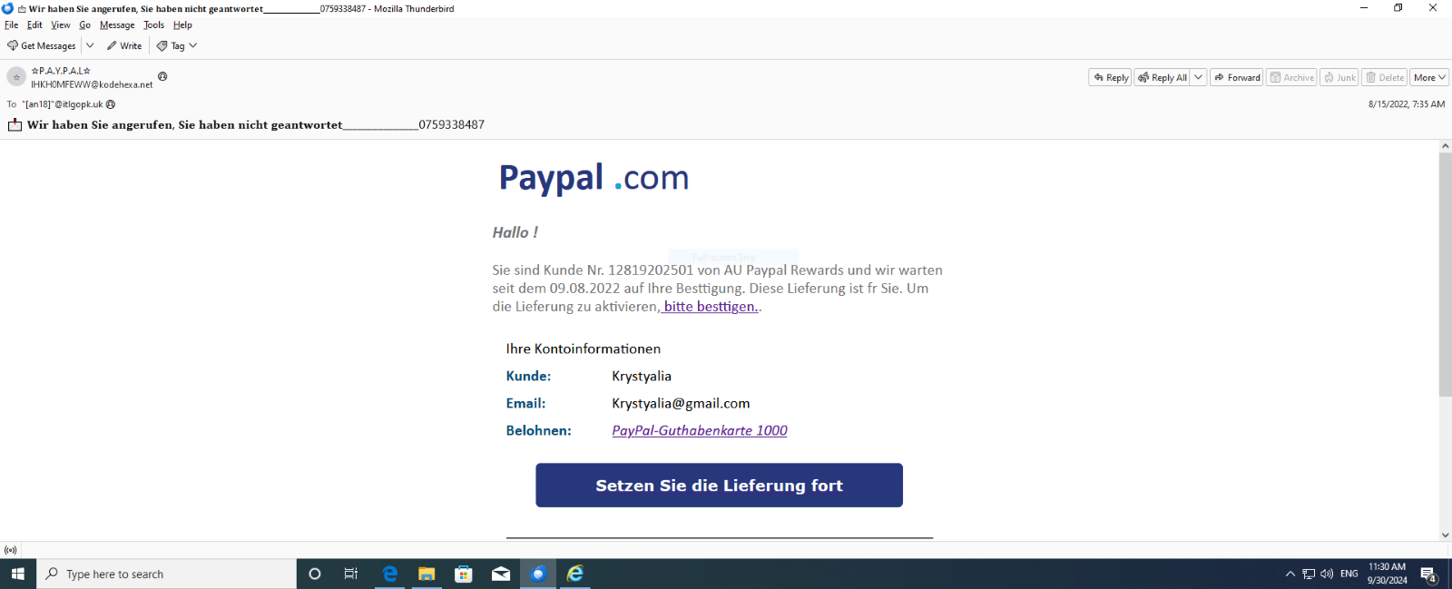
PHISHING EMAIL

Slide 30
2.PHISHING EMAIL ANALYSIS
A phishing email designed to look like it’s from PayPal
The sender address is IHKH0MFEWW@kodehexa.net, which is not a legitimate PayPal domain
The subject line is in German: "Wir haben Sie angerufen, Sie haben nicht geantwortet” , followed by a phone number. This is an example of a social engineering tactic to create a sense of urgency and prompt the recipient to respond without verifying
The message uses the PayPal logo to appear legitimate.

Slide 31
PHISHING EMAIL ANALYSIS
The button “Setzen Sie die Lieferung fort” (Continue with the delivery) leads to a suspicious link. This is likely an attempt to capture sensitive information such as login credentials.
Delivered-To: krystalia@gmail.com Indicates the recipient's email address
Received Fields
Purpose: Each Received entry records a step in the email's journey, from the original sender to the final recipient
This line shows that the email was processed by Google’s server ip with a timestamp indicating it was handled on August 15th, 2022, at 7:35 AM
Return-Path: <bounce@rjtzntyzzjjzydnillquh.designclub.uk.com> The Return-Path specifies where undelivered messages should be sent back
Suspicious Indicator: The domain (designclub.uk.com) does not match PayPal’s legitimate domain, suggesting that the email may be spoofed or sent from an unauthorized server.

Slide 32
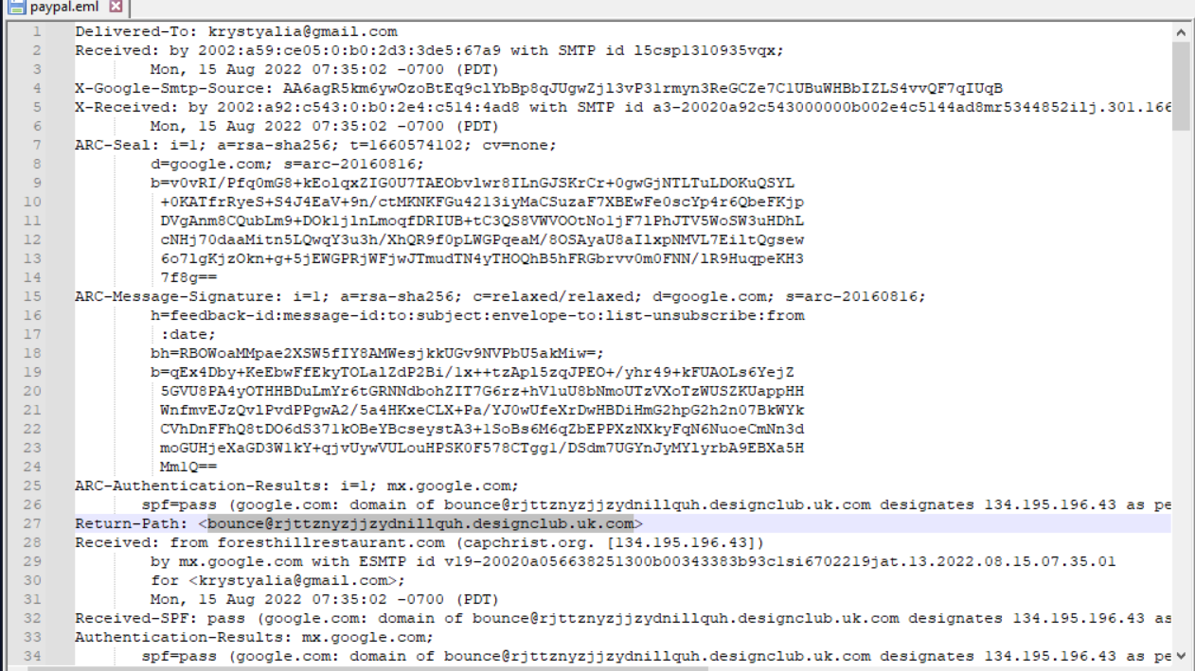

Slide 33
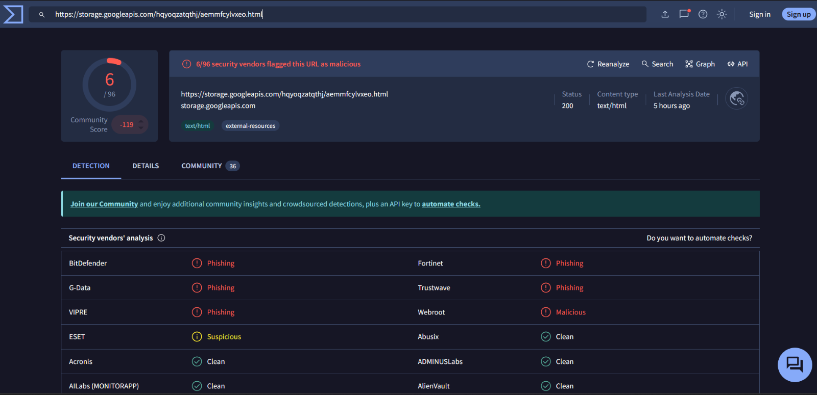
5. PHISHING EMAIL ANALYSIS
By right-clicking on the button, copying the link, and upload the URL to VirusTotal to do some initial reputation checks. We can see that 6 out of 96 security vendors have flagged this URL as malicious.

Slide 34
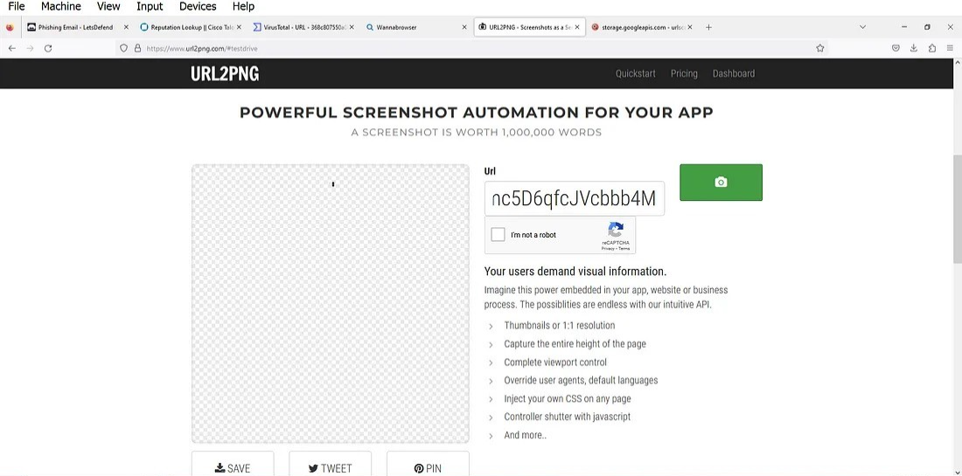
PHISHING EMAIL ANALYSIS
URL2PNG is a tool that converts URLs to PNG images, allowing you to capture the visual representation of web pages quickly.
When we put the URL into URL2PNG to see what the page looks like. It is not loading which means it is either not legitimate or there is no content and the site does not show any homepage.

Slide 35
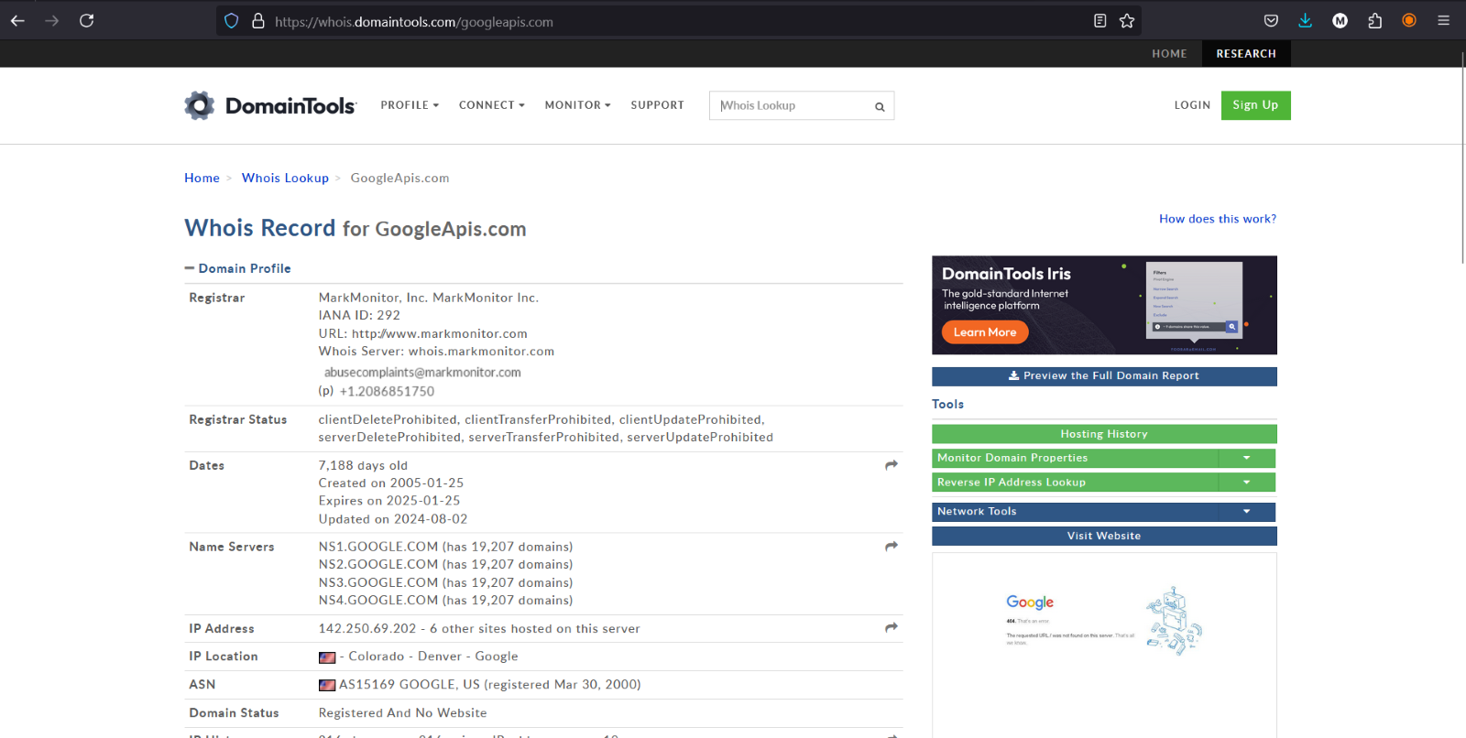
PHISHING EMAIL ANALYSIS
Check the domain <storage.googleapis.com> usign DomainTools whois lookup

Slide 36
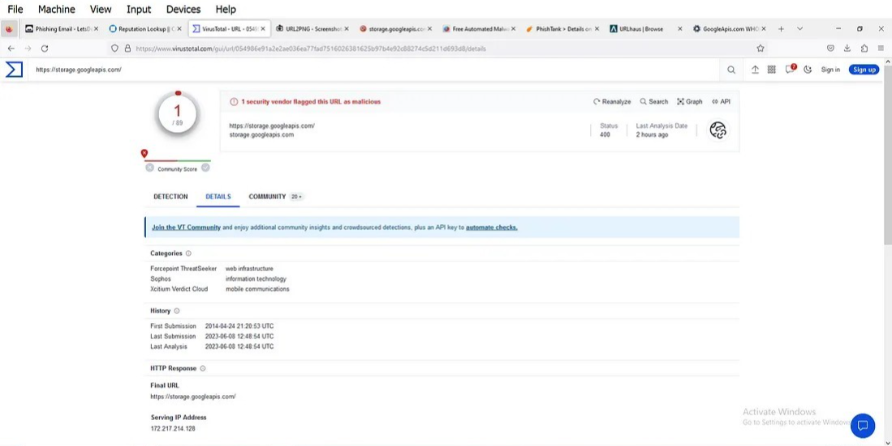
PHISHING EMAIL ANALYSIS
Check the domain <storage.googleapis.com> on virustotal We can see that 1 out of 89 security vendors have flagged this URL as malicious.
Virustotal is a tool that used to analyse suspicious files, domains, IPs and URLs to detect malware and other breaches, automatically share them with the security community.

Slide 37

5. PHISHING EMAIL ANALYSIS
Based on the above analysis we can see the email is actually a phishing email that has a hyperlink that is hosting a malicious URL

Slide 38
5.2 CONTAINMENT
Isolate Affected Systems
Disconnect compromised systems from the network to prevent further damage
Use endpoint detection and response tools like CrowdStrike or Carbon Black to isolate infected endpoints
Quarantine Malicious Emails
Use email filtering tools to quarantine the phishing email from all user inboxes
Ensure that any internal email forwarding rules set by the attacker are removed
Alert the affected users immediately
Implement account resets if credentials were compromised
Isolate the affected systems if necessary

Slide 39
5.3 ERADICATION AND RECOVERY
Remove Malicious Artifacts
Delete phishing emails from users’ inboxes
Ensure that the phishing website and email are blocked
Remove any malicious software installed by phishing attachments
Patch & Update
Apply security patches if vulnerabilities were exploited
Update security configurations, including email filters and spam detection rules
Restore systems to a known good state
Conduct a post-incident review with the Incident Response team
Discuss what went well and areas for improvement

Slide 40

6. REPORTING AND METRICS
Percentage of employees who
Opened the email
Clicked on the phishing link
Submitted sensitive information

Slide 41
6.2 IR TEAM PERFORMANCE METRICS
Time taken to detect the phishing simulation
Time taken to respond and mitigate the attack
Accuracy of the analysis and containment
Improvement in user awareness before and after training
Reduction in the number of phishing-related incidents post-training

Slide 42
THE ROOT CAUSE OF PHISHING ATTACK
Lack of Awareness
Employees were unaware of the basic signs of phishing
Insufficient Training
Previous training sessions did not focus enough on social engineering tactics and psychological manipulation used in phishing
Human Error
Many users tend to trust emails that appear visually legitimate, especially if they mimic known brands
Inadequate Technical Safeguards
Spam filters and security tools were not fully optimized, allowing simulated phishing emails to bypass safeguards

Slide 43
THE IMPACT OF PHISHING ATTACK
The Impact of Phishing attack
Phishing attacks can have severe and wide-ranging consequences on an organization or individual
Financial Losses
Direct monetary losses can occur due to fraudulent transactions or unauthorized access to financial accounts
Indirect costs include recovery expenses, legal fees, and potential fines for non-compliance with data protection regulations
Data Breach and Information Theft
Phishing can lead to unauthorized access to sensitive data such as login credentials, intellectual property, and customer information
Compromised information can result in identity theft, insider trading, or resale of data on the dark web

Slide 44

THE IMPACT OF PHISHING ATTACK
Reputation Damage
Organizations that fall victim may experience a loss of trust and credibility among customers and stakeholders
Negative media coverage and the perception of poor security practices can deter future clients and impact business growth
Business Disruption
Phishing attacks can lead to downtime in critical systems, interrupting business operations
Legal and Compliance Issues
Organizations may face legal action or penalties for failing to protect customer data
Increased Security Costs
After a phishing attack, companies often need to invest heavily in security upgrades, training, and recovery processes
Organizations may also have to hire external consultants to assess vulnerabilities and prevent future incidents

Slide 45
CONCLUSION
Implementing a phishing attack simulation and training program is a crucial step in strengthening an organization’s cybersecurity posture
The key takeaway from this exercise is that human error is a critical factor in most successful phishing attacks, making regular training and continuous awareness essential

